Slide 1

Machine Learning Project
Long Short / Weekly Buy Sell Signals for S&P 500
Team 1: -
Achal Shah - ads925
Prajwal Pitlehra - pp2696
Tania Suresh - tns9572

Slide 2

Data
The S&P 500, is a stock market index tracking the stock performance of 500 large companies listed on stock exchanges in the United States.
Source of Data - Yahoo Finance(yfinance) is a module in Python, which is used to collect online data, and with it, we can collect the financial data of Yahoo. It's an open-source tool that uses Yahoo's publicly available APIs, and is intended for research and educational purposes.
Training Data Period - 1928 to 2008 with Weekly Frequency
Testing Data Period - 2009 to 2021 with Weekly Frequency
Source - https://pypi.org/project/yfinance/

Slide 3
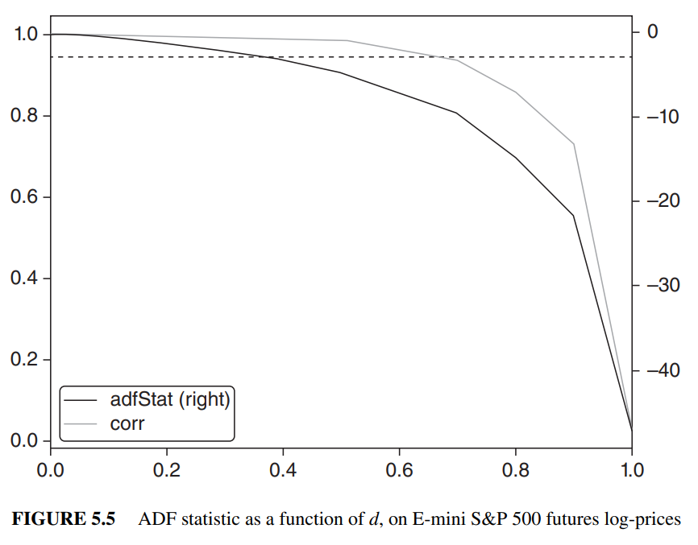
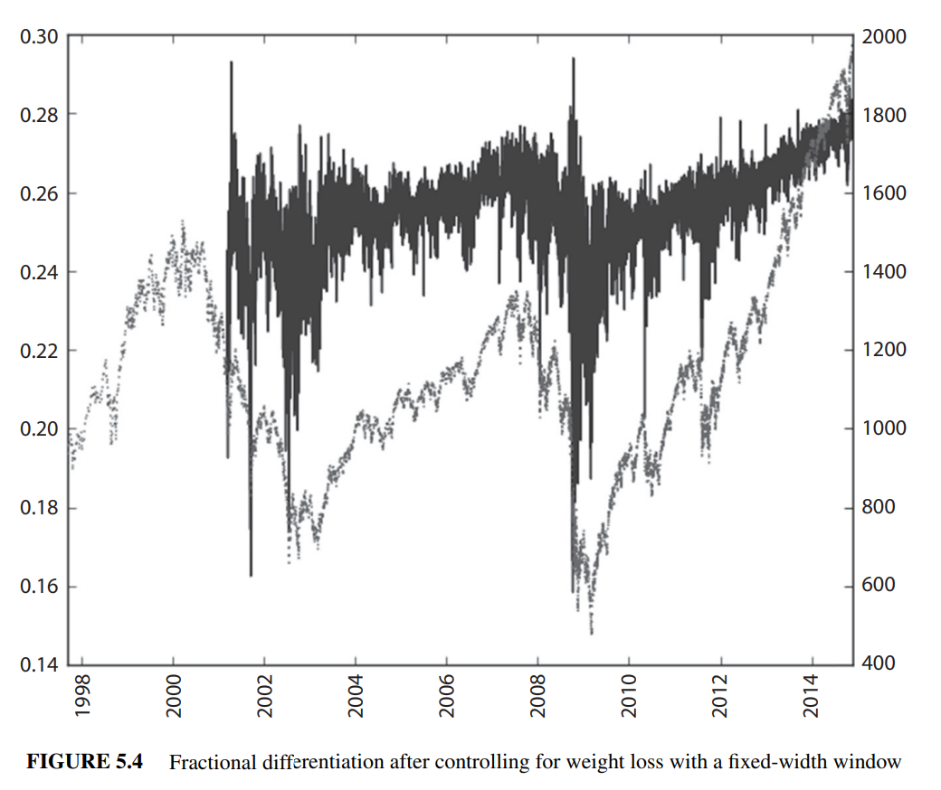
Feature Engineering
Fractional Differentiation - General Practice is to take returns/log prices for stationarity but that leads to memory loss on the other hand price has memory but is not stationary. Therefore, for trade-off used fractional differentiation instead of integer differentiation.
Library - https://github.com/simaki/fracdiff
Source - 5.6 STATIONARITY WITH MAXIMUM MEMORY PRESERVATION, Advances in Financial Machine Learning (Marcos Lopez de Prado)

Slide 4
Feature Engineering
2. Technical Indicators: -
Average True Range - The true range indicator is taken as the greatest of the following: current high less the current low; the absolute value of the current high less the previous close; and the absolute value of the current low less the previous close. The ATR is then a moving average. (Volatility)
Relative Strength Index - The index compares a security's strength on days when prices go up to its strength on days when prices go down. (Momentum)
On-Balance Volume - It is a technical indicator of momentum, using volume changes to make price predictions. (Volume)
Weighted Close Price - Weighted Average Closing Price means the average of the closing bid and asked prices of the Common Stock quoted in the over-the-counter market summary or the last reported sale price. (Price)
Hilbert Transform - In mathematics and in signal processing, the Hilbert transform is a specific linear operator that takes a function, u(t) of a real variable and produces another function of a real variable H(u). (Trend vs Cycle)
Kalman Filter - For statistics and control theory, Kalman filtering, also known as linear quadratic estimation (LQE), is an algorithm that uses a series of measurements observed over time, including statistical noise and other inaccuracies, and produces estimates of unknown variables that tend to be more accurate than those based on a single measurement alone. (minimizes the state of error variance)
Libraries - https://mrjbq7.github.io/ta-lib/
https://pykalman.github.io/
Source - https://www.investopedia.com/terms/t/technicalindicator.asp

Slide 5
Model Stacked Ensemble and Predictions
Independent variables - Open, High, Low, Adjacent Close, Volume, Average True Range, Relative Strength Index, On-Balance Volume, Weighted Close Price, Hilbert Transform, Kalman Filter
Dependent variable - Shift Weekly Price and for positive change transform into 1 and for negative change transform into -1 for classification.
Models Used - Adaboost Classifier and Catboost Classifier
Signals -
Adaboost
2 = Buy
Stacked Ensemble Signal
0 = No Opportunity
Catboost
-2 = Sell
Source - https://machinelearningmastery.com/tour-of-ensemble-learning-algorithms/

Slide 6
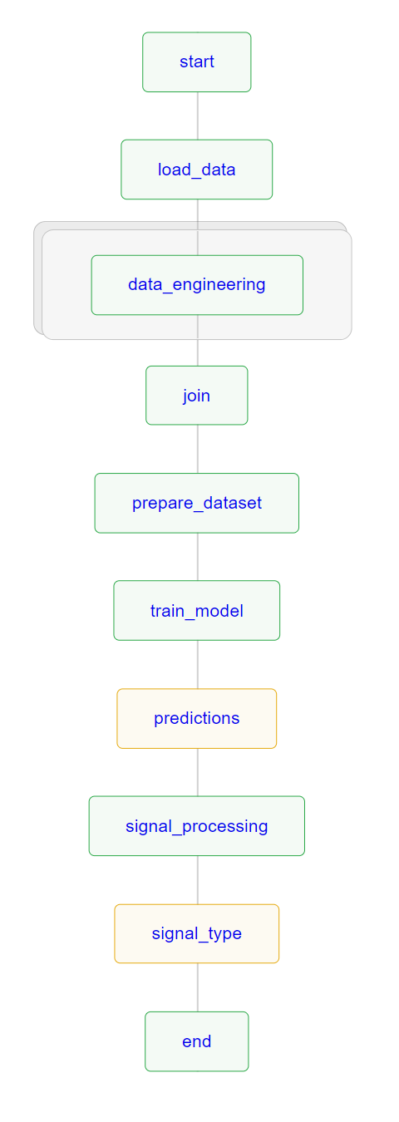
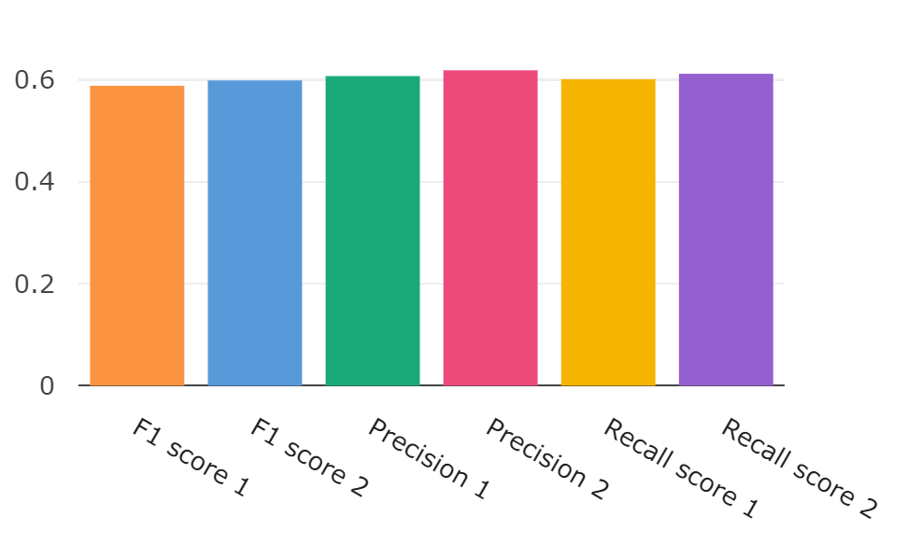
Metaflow, Metrics and Webpage Link
Google Cloud Platform Link - https://mlfin-370922.ue.r.appspot.com
score 1 - Adaboost Model
score 2 - Catboost Model
Source - https://www.youtube.com/watch?v=xcODUk0o6tU/

Slide 7
Thank you
Source - https://pypi.org/project/yfinance/

